Slide 1

Credit Card Fraud Detection Using Machine Learning
This presentation explores the development of a machine learning model for detecting fraudulent credit card transactions. The project leverages a real-world dataset, employing data preprocessing techniques to address class imbalance and enhance model performance. This presentation outlines the key steps involved, from data exploration to model evaluation, and highlights the effectiveness of the proposed approach.
Ts
by Tohid sayyed

Slide 2

Motivation and Objectives
1
Financial Security
2
Loss Minimization
Protect consumers from fraudulent activity and secure financial transactions.
Reduce financial losses for both businesses and individuals due to fraudulent transactions.
3
Fraud Detection
4
Data Analysis
Develop an effective machine learning model for accurate identification of fraudulent transactions.
Gain insights into the characteristics of fraudulent transactions and identify patterns.

Slide 3
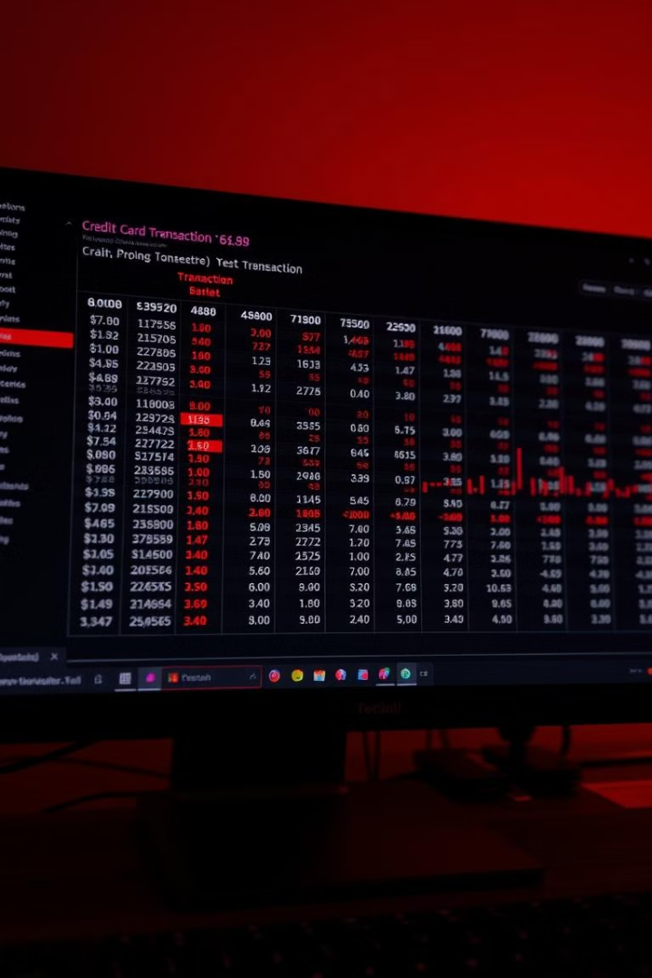
Dataset Overview and Characteristics
Feature
Description
Time
Number of seconds elapsed between the first transaction and the current transaction.
Amount
Transaction amount in euros.
V1-V28
Principal components obtained through PCA, protecting sensitive cardholder information.
Class
Target variable indicating whether a transaction is fraudulent (1) or legitimate (0).

Slide 4
Data Preprocessing and Balancing
Data Cleaning
Undersampling
Data Splitting
Remove missing values and outliers from the dataset, ensuring data integrity.
Reduce the number of instances in the majority class (legitimate transactions) to balance the dataset.
Divide the dataset into training and testing sets for model development and evaluation.

Slide 5




Feature Engineering and Standardization
Feature Selection
Identify relevant features that contribute to fraud detection accuracy.
Feature Scaling
Standardize numerical features to ensure equal weight across variables.
Feature Transformation
Apply transformations like log or square root to improve model performance.

Slide 6

Logistic Regression Model Development
Model Training
Train the Logistic Regression model using the preprocessed and balanced dataset.
Model Evaluation
Assess the performance of the trained model on the testing dataset.
1
2
3
Model Optimization
Fine-tune model parameters using techniques like cross-validation and grid search.

Slide 7
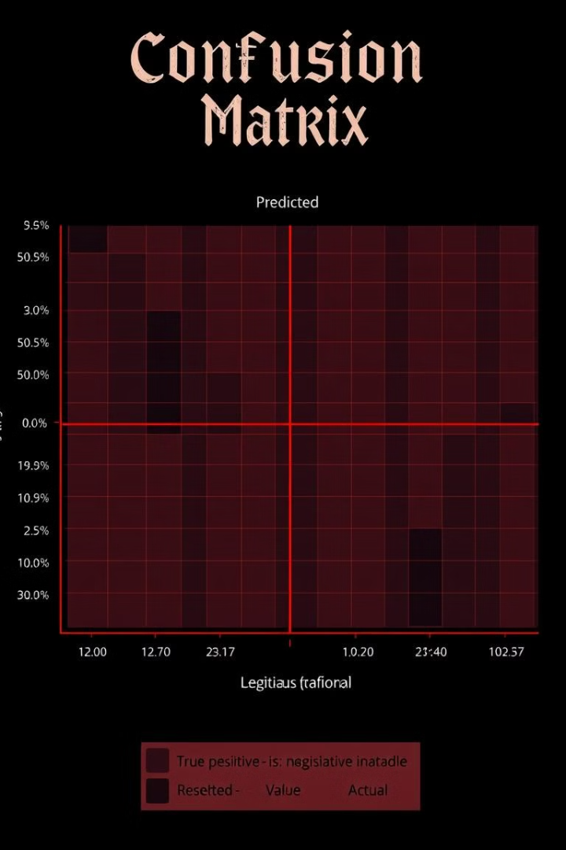
Model Performance Evaluation
Accuracy
Precision
Percentage of correctly classified transactions.
Ability of the model to correctly identify fraudulent transactions.
Recall
F1-Score
Model's ability to detect all fraudulent transactions.
Harmonic mean of precision and recall, providing a balanced evaluation of the model's performance.

Slide 8
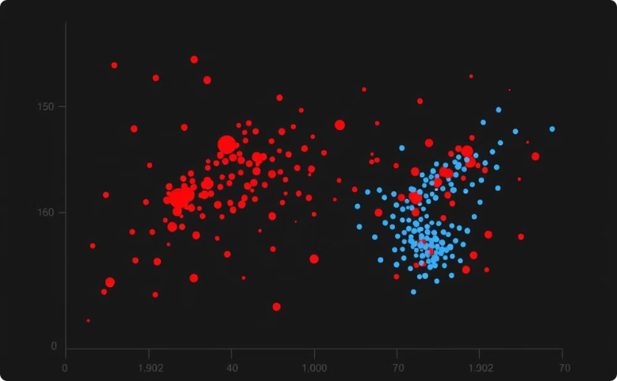
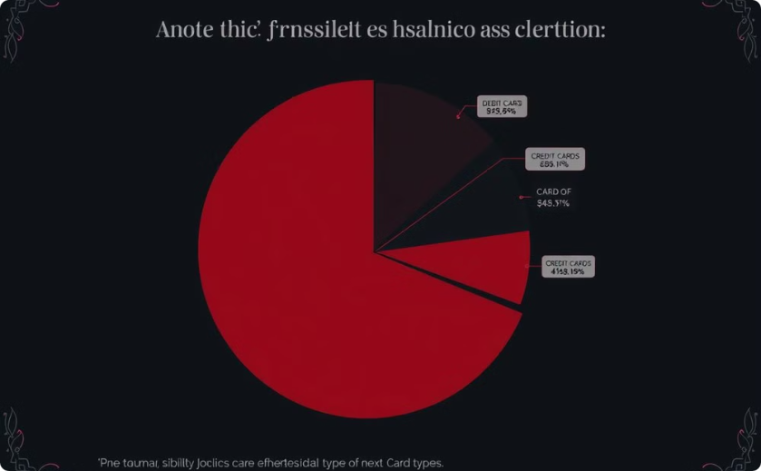
Visualization of Class Distributions
Distribution of Transactions
Fraudulent Transactions by Card Type
Visualize the distribution of fraudulent and legitimate transactions based on various features like transaction amount, time, and others.
Analyze the distribution of fraudulent transactions across different card types to identify potential patterns.

Slide 9
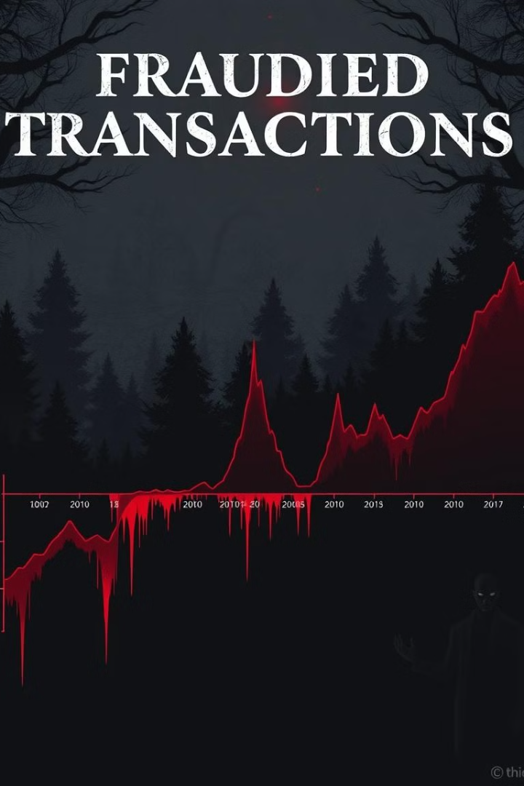




Analysis of Transaction Patterns
Temporal Patterns
Geographical Patterns
Identify recurring fraudulent activity at specific times of the day or week.
Analyze the geographical distribution of fraudulent transactions to identify hotspots.
Network Analysis
Merchant Analysis
Investigate relationships between fraudulent transactions and involved parties.
Identify high-risk merchants associated with a significant number of fraudulent transactions.

Slide 10

Limitations and Future Improvements
1
Data Availability
2
Model Complexity
Limited access to real-world datasets with a comprehensive range of features and fraudulent transactions.
Explore advanced models like Random Forest and Support Vector Machines (SVM) for improved performance.
3
Real-Time Monitoring
4
Collaboration
Enhance fraud prevention efforts by collaborating with financial institutions, law enforcement agencies, and industry experts.
Implement real-time fraud detection systems to analyze transactions as they occur and trigger alerts.

